Slide 1
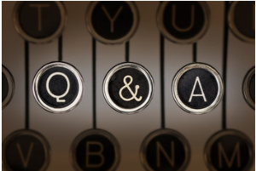

DSI – Capstone Project Quora Insincere Questions
Technical Presentation
Ruoran Huang

Slide 2


Introduction
“An existential problem for any major website today is how to handle toxic and divisive content.

Slide 3
Project Summary
Objective
Correctly Identify insincere questions.
Data Set Stats
Total no. of questions: 1.31m
No. of sincere questions: 1.22m
No. of insincere questions: 0.08m
% of insincere questions: 6.2%
Baseline accuracy: 93.8%
Challenges
Large data set, long computation time
Imbalanced data set, use F1 Score

Slide 4
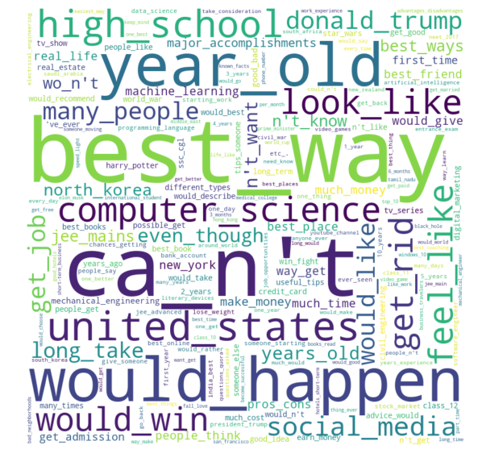
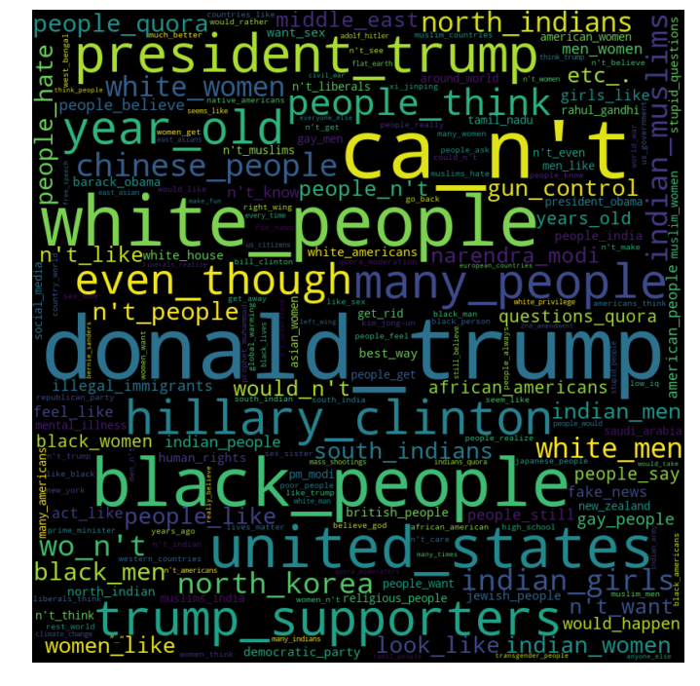
EDA
Sincere Questions
Insincere Questions

Slide 5
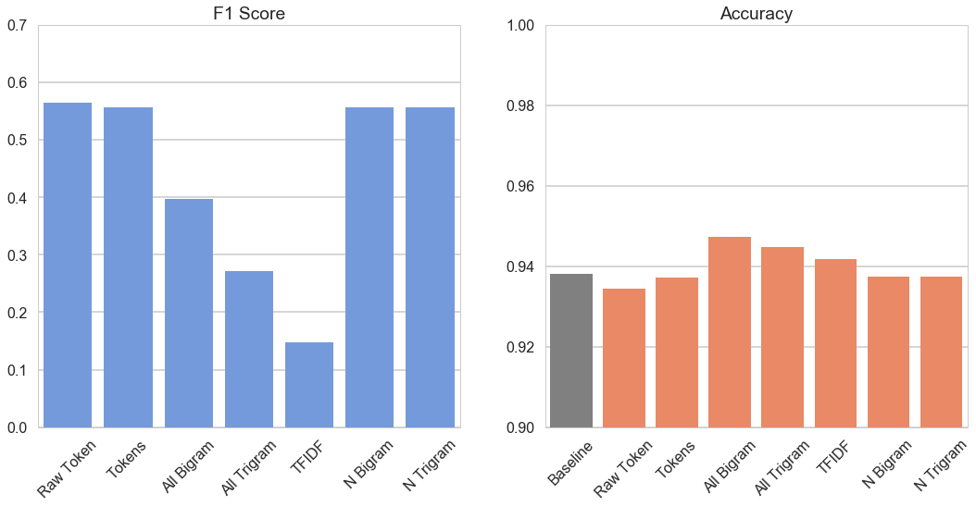
Base Text Bag of Words NB
Cleaning: Remove non-alphabet characters, remove stop-words
Model: CountVectorize, Naïve Bayes
TFIDF |  | Predicted
 |  | 0 | 1
Actual | 0 | 99.8% | 0.2%
 | 1 | 91.9% | 8.1%

Slide 6
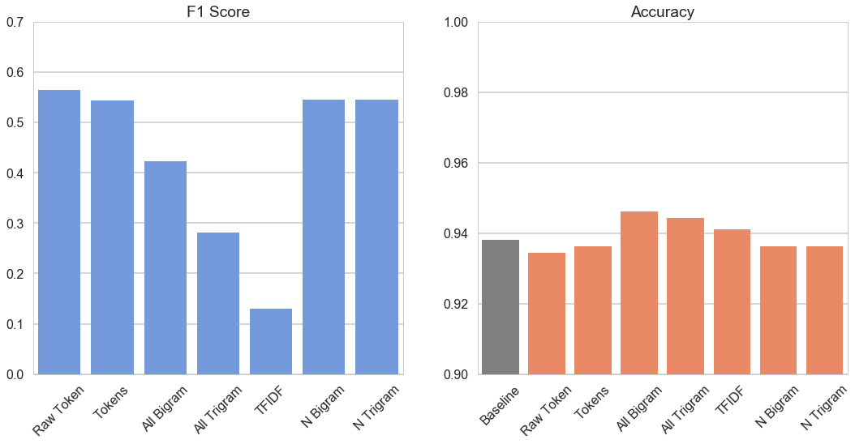
Lemmatized Bag of Words NB
Cleaning: Remove non-alphabet characters, remove stop-words, lemmatized using SpaCy POS tagging
Model: CountVectorize, Naïve Bayes

Slide 7
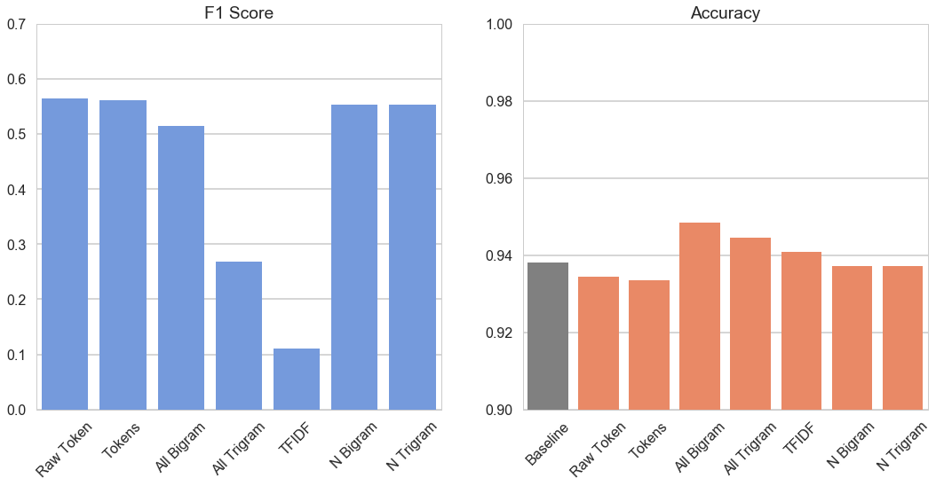
Identity Label Bag of Words NB
Cleaning: Remove non-alphabet characters and stop-words. Replace racial, religious, nationality with common labels
Model: CountVectorize, Naïve Bayes

Slide 8
LSTM modelling
Advantages
Embedding able to capture complex meaning of words.
Pre-trained embedding can be used, such as Word2Vec.
Auto select best features(words) through backpropagation.
Disadvantages
Very long computation time.
Blackbox

Slide 9
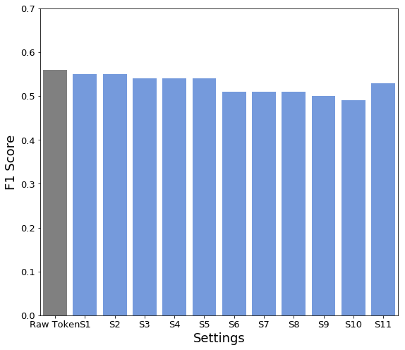
Conv1D LSTM Modelling
Layers | Parameters
LSTM | No. of Embedding Words
 | Embedding Dimension
 | LSTM Units
 | Drop Rate
Convolutional | Filter
 | Kernel
 | Pool Size
Cleaning: Remove non-alphabet characters and stop-words
Model: Single Convolutional layer + LSTM, 3 Epoch

Slide 10
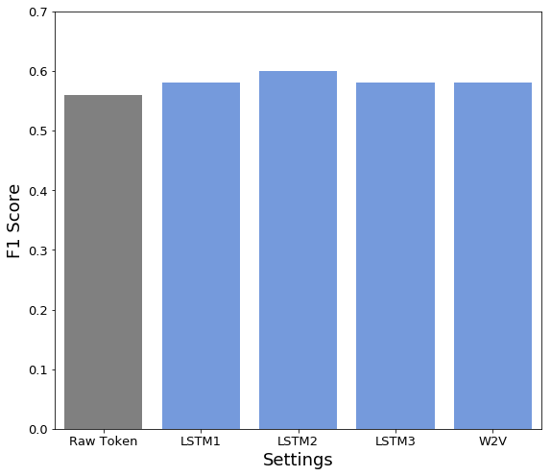
LSTM Modelling
Label | No. of Embedding Words | Embedding Dimension | LSTM Output | Drop Rate
LSTM1 | 100k | 100 | 100 | 0.2
LSTM2 | 160k | 300 | 100 | 0.2
LSTM3 | 160k | 300 | 100 | 0.4
W2V | 160K | 300 | 100 | 0.2
Cleaning: Remove non-alphabet characters and stop-words
Model: LSTM, 3 Epoch

Slide 11
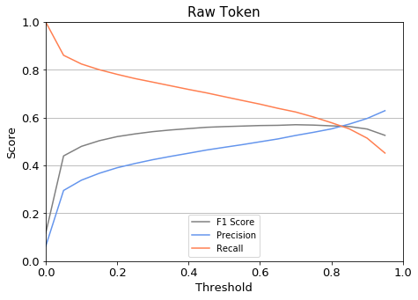
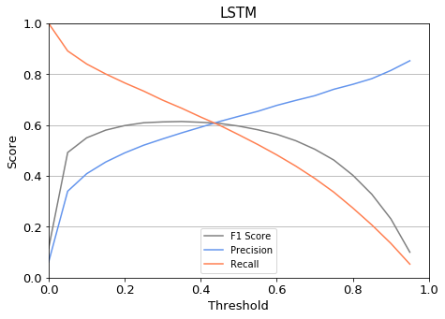
Activation Threshold
Threshold | Capture rate | False Positive
0.1 | 82% | 11%
0.2 | 78% | 8%
0.3 | 76% | 7%
Threshold | Capture rate | False Positive
0.1 | 86% | 8%
0.2 | 77% | 5%
0.3 | 70% | 4%

Slide 12
Summary
Accurately predicting insincere questions is difficult, due to it’s ambiguous nature and the complexity of NLP.
LSTM models with large vocabulary and high dimension had the most success.
Activation Threshold can be adjusted to maximise the capture rate of insincere questions.
Significant manual filtering of model results will still be required.
Given time there are more features I can change with Neural Network models, which should be able to increase accuracy further.

Slide 13
Questions ?

